Slide 1


Slide 2
Goal

Slide 3
인공지능 적용을 위한 플랫폼 완성

Slide 4
Current Progress
Team A
Team B

Slide 5
Last Progress – Team A
Snake
Snack

Slide 6
Current Progress – Team A
Snake
Snack
= []
= []
… n
… n

Slide 7
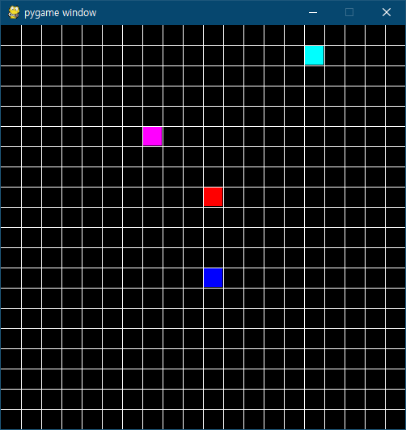
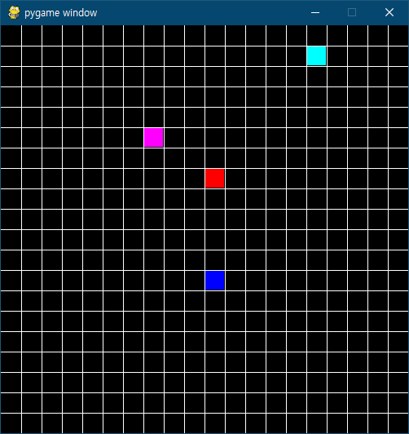
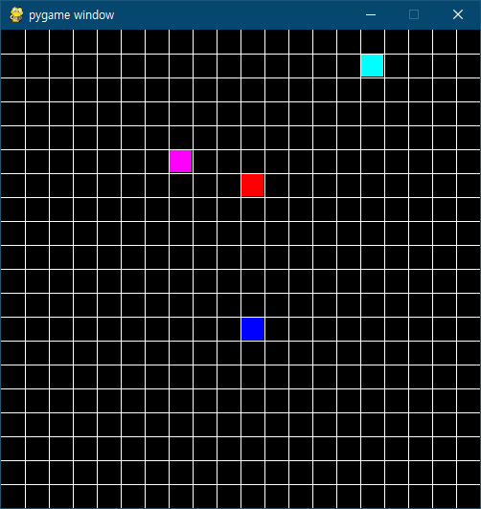
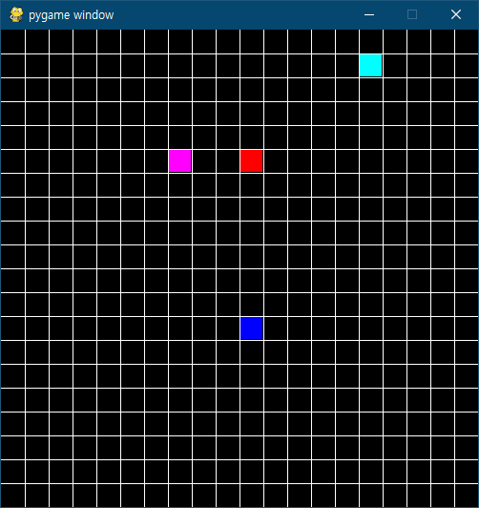
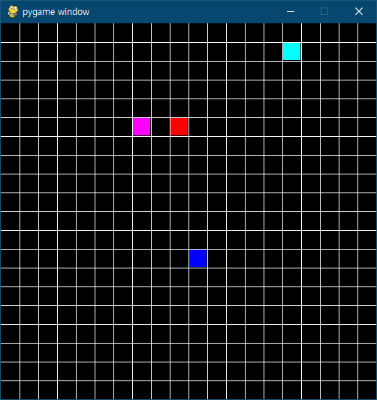

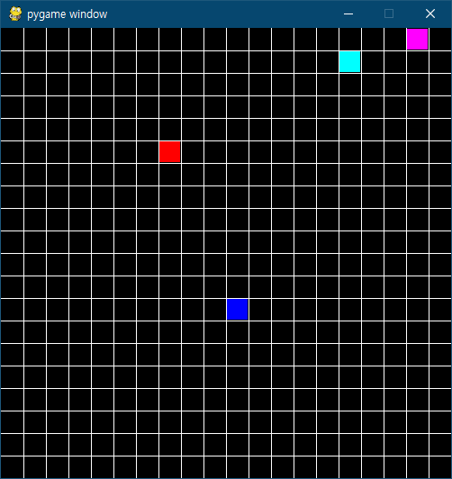
Current Progress – Team A
Next Snack
Snake[0].pos == Snack[0].pos
SUCCESS

Slide 8
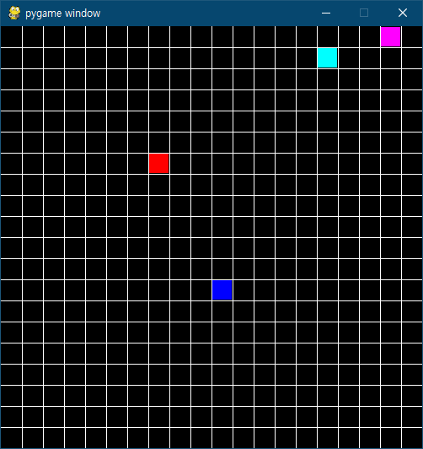
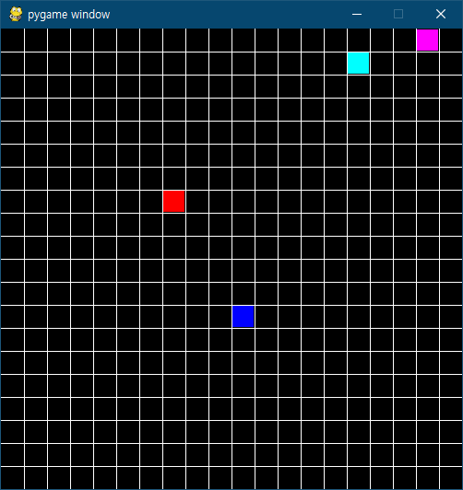
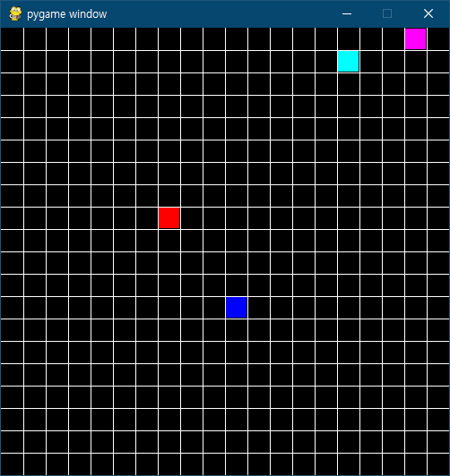
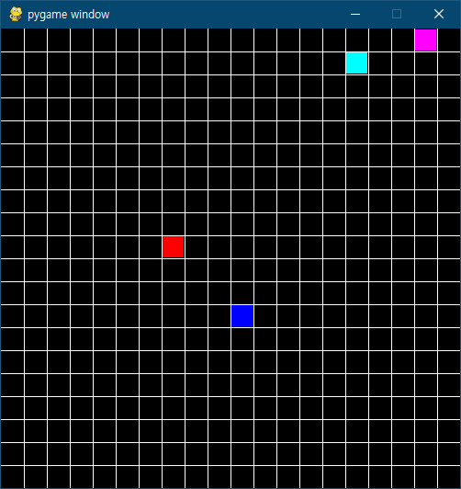
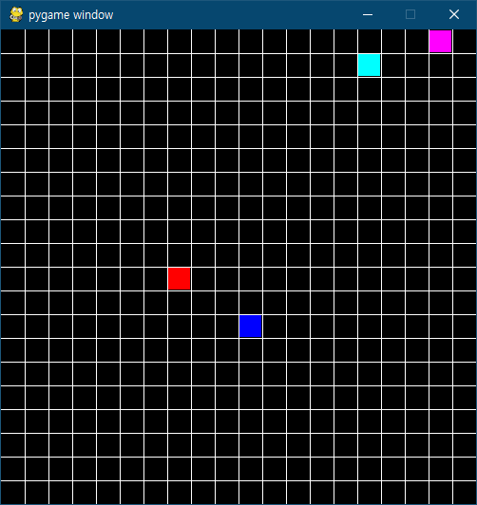
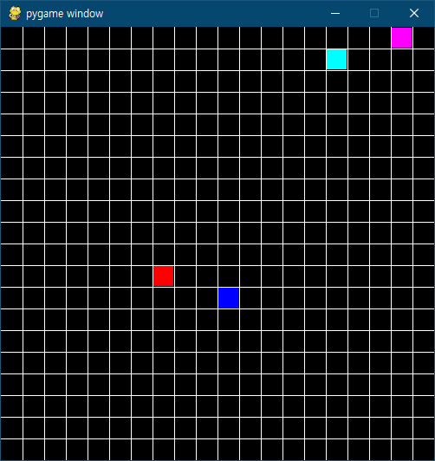
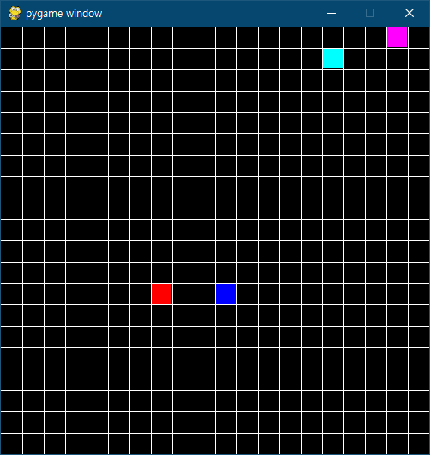
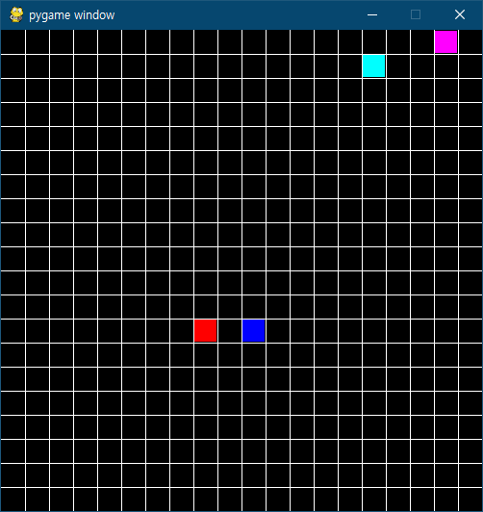
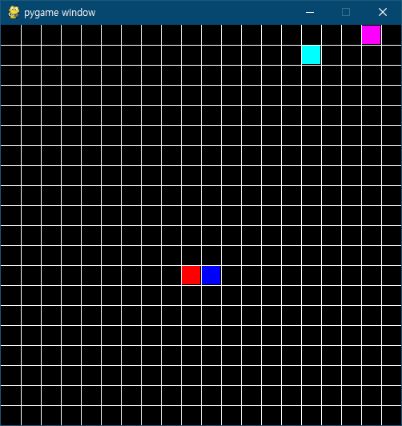
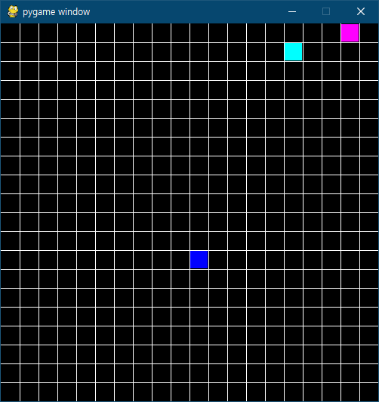
Current Progress – Team A
FAIL
Snake[0].pos == Snake[1].pos

Slide 9
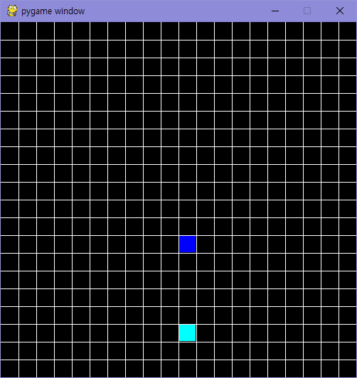
Last Progress – Team A

Slide 10
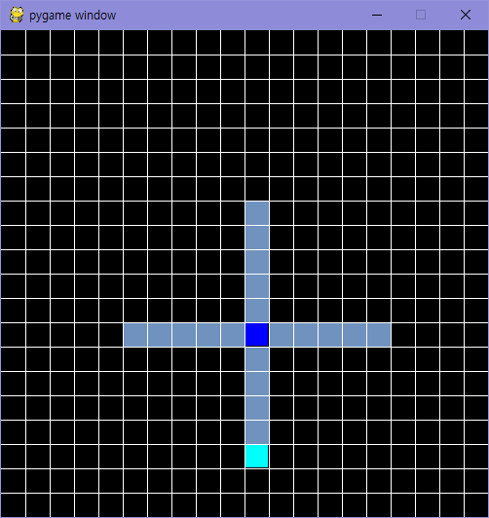
Current Progress – Team A
Snake[0].pos + i == Snack[0].pos
SENSOR
0.2
0.4
0.6
0.8
1.0
Input Layer
1 - 0.2 * i
Output Layer
Up, Down, Left, Right

Slide 11
Next Progress – Team A
Output Layer
Shadow
(Neuron)
Output
Weight

Slide 12
Current Progress – Team B
Console Environment
PyGame Environment

Slide 13
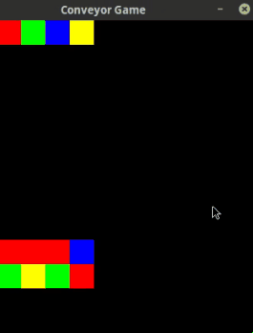
Next Progress – Team B
Chromosome
Chromosome
Chromosome
Map
Chromosome
Chromosome
Chromosome
Chromosome
Chromosome
Chromosome
Generation 1
Generation 2
Generation 3

Slide 14
Thank You

